Slide 1


THE BOOKTOWN
Presented by
AKSHAY SHINDE(229087)
KSHITIJ CHANDAN(229041)

Slide 2
Point to be Disscuss through out the Presentation
Introduction
Motivation
Objective
UML Diagrams
Screenshot
Specifications
Software Requirement
Hardware Requirement
Advantages
Disadvantages
Conclusion
Future Enhancement
References

Slide 3
Introduction
This project is a web-based books shopping system for multiple vendors to sell their books and customer to buy the books. The project objective is to deliver the online books shopping application into web platform.
As a customer point of view without going to a shop physically but using the web application he/she can order the book at your doorsteps

Slide 4

As a local vendor or shop they can sell the books in their locality only if they want to expand physically a lot of cost is required
As a customer point of view you have to visit the book store to buy the book and you don’t know whether that store have the book that you want and it cost time

Slide 5
Objective
The objective of the project is to make an web application to purchase books. In order to build such an application complete web support, need to be provided. A complete and efficient web application which can provide the online book shopping experience is the basic objective of the project.

Slide 6
Unified Modelling language (UML Diagram)

Slide 7
Admin
Manage Users and Full Application
Manage Buyers
Admin
Manage Vendors
Login and Logout from System
Check Product details
Change Account Password
Check Product reviews

Slide 8
Vendor
Create Product Details
Update Product Details
Vendor
Login and Logout from System
Change Account Password
View Product Details
search Product

Slide 9
User
Login and Logout from System
User
Change Account Password
search Product
Make Payment
View Product Details
Add To Cart

Slide 10
Entity Relationship Diagram

Slide 11
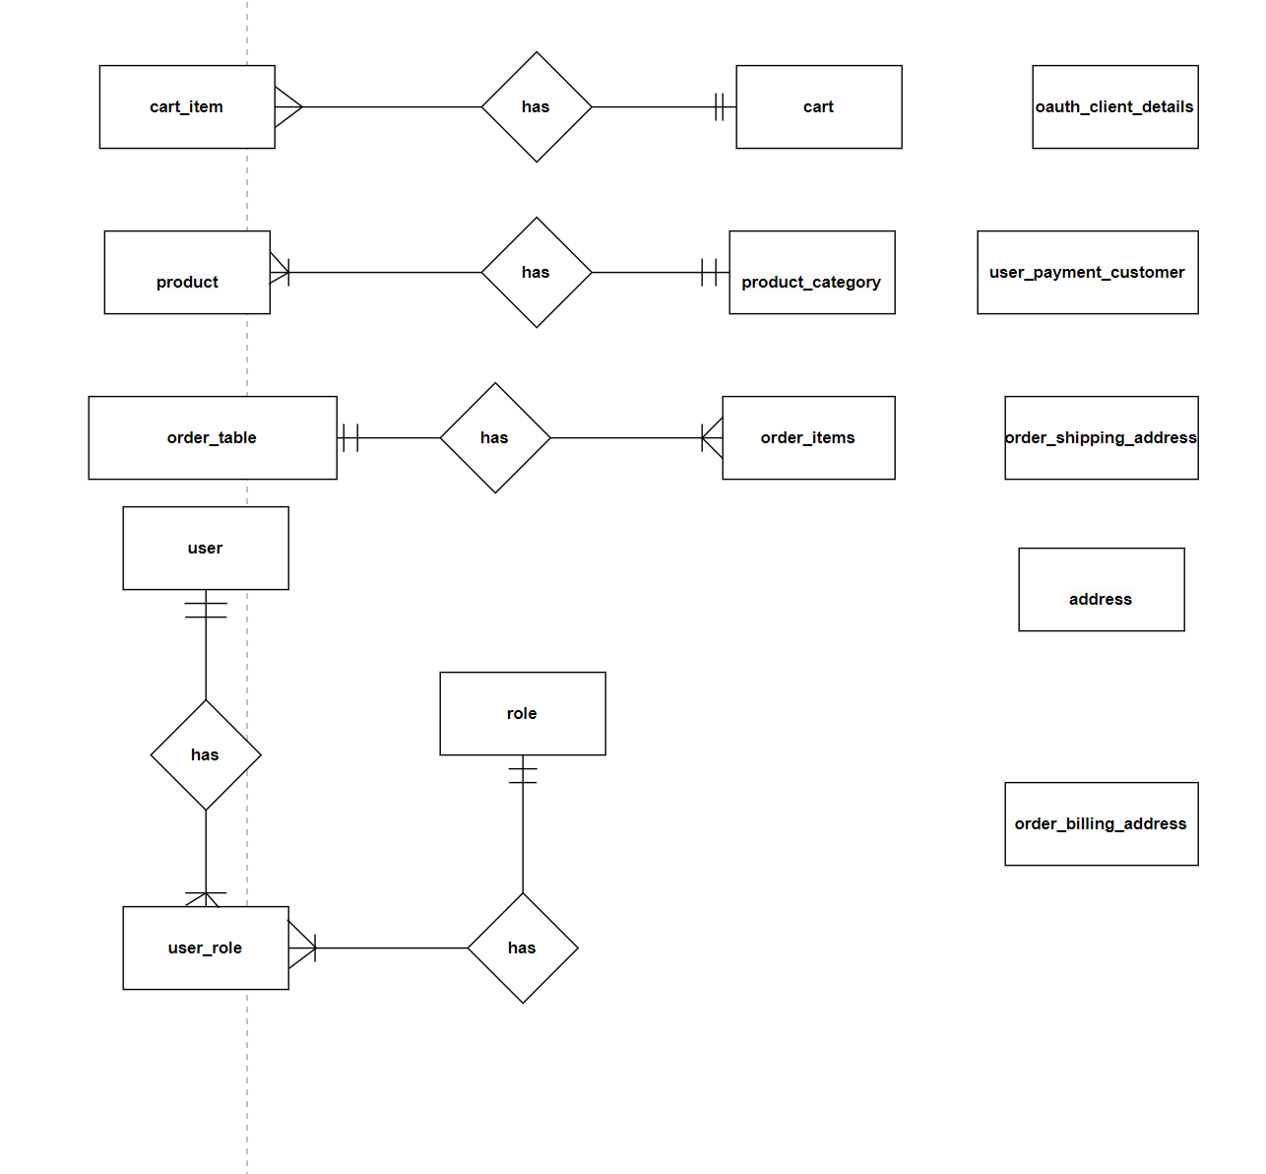

Slide 12
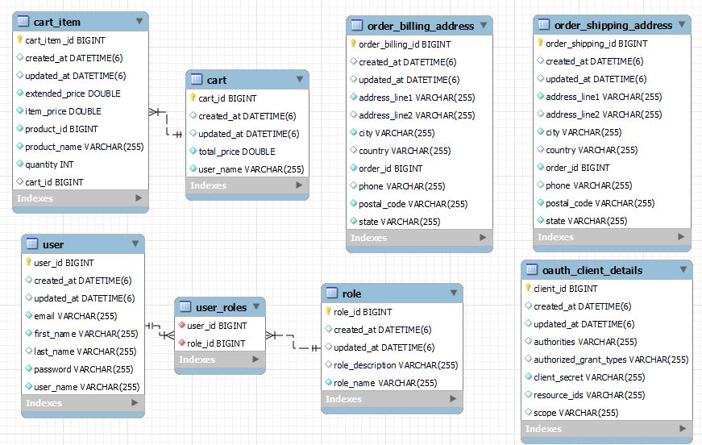

Slide 13
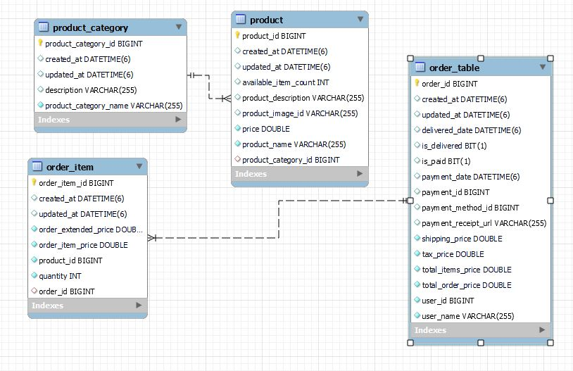

Slide 14
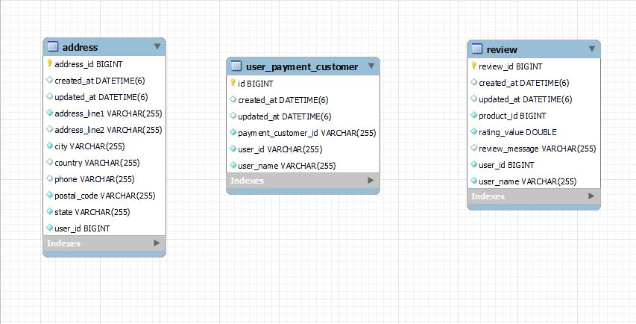

Slide 15
Activity Diagrams

Slide 16
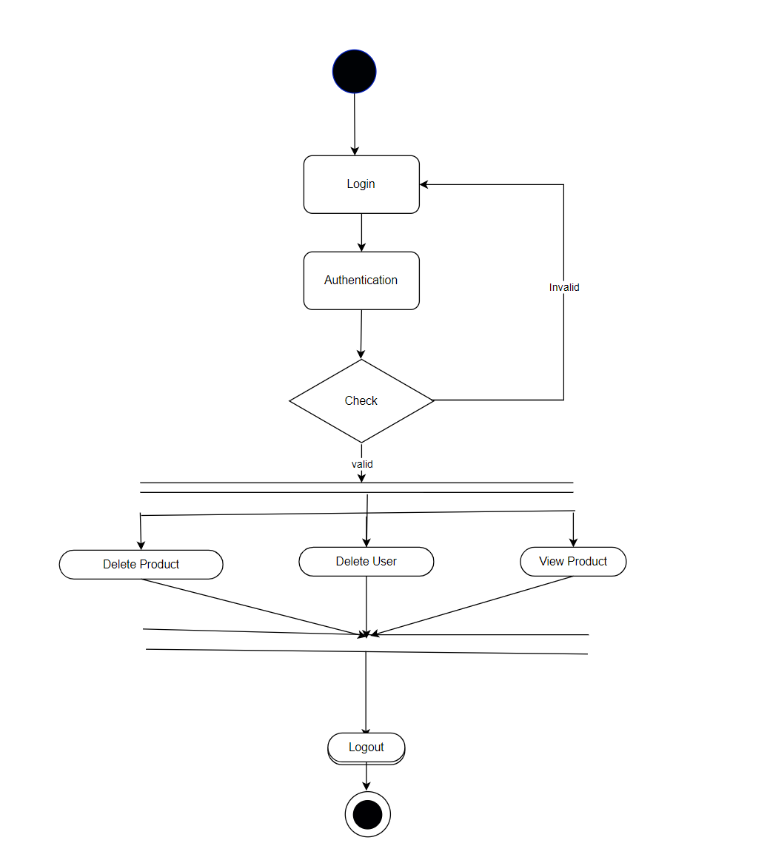
Activity Diagram of Admin

Slide 17
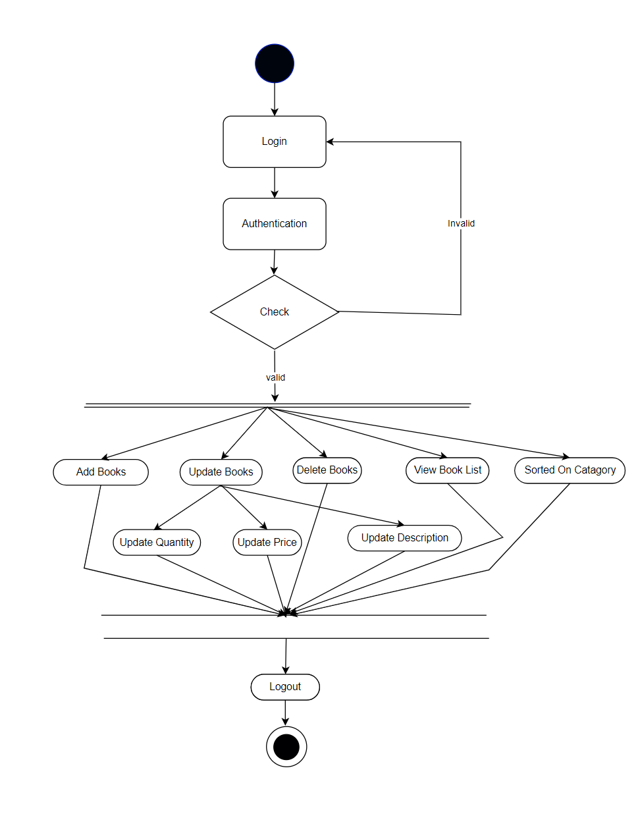
Activity Diagram of Vendor

Slide 18
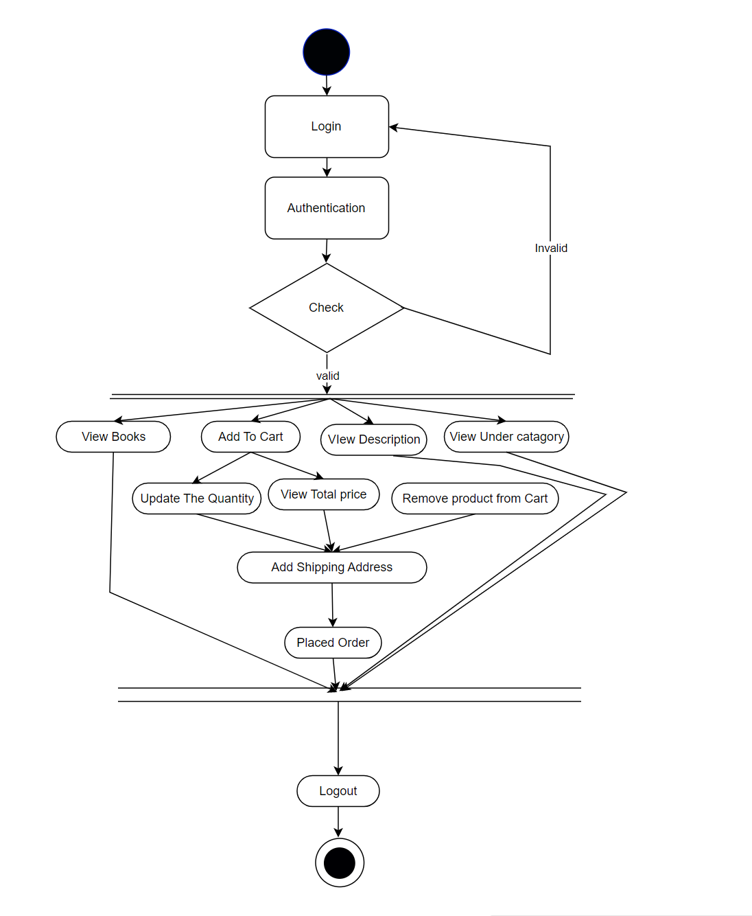
Activity Diagram Of User

Slide 19
Screenshots

Slide 20
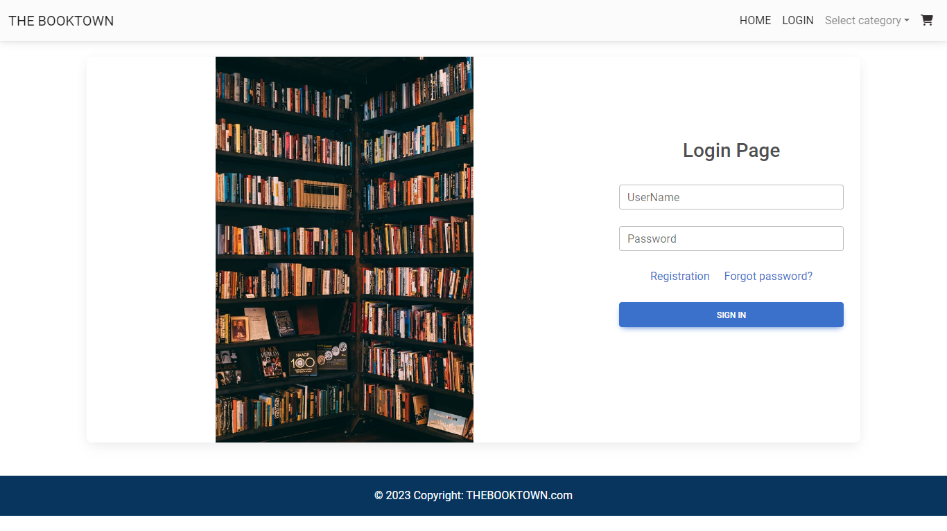
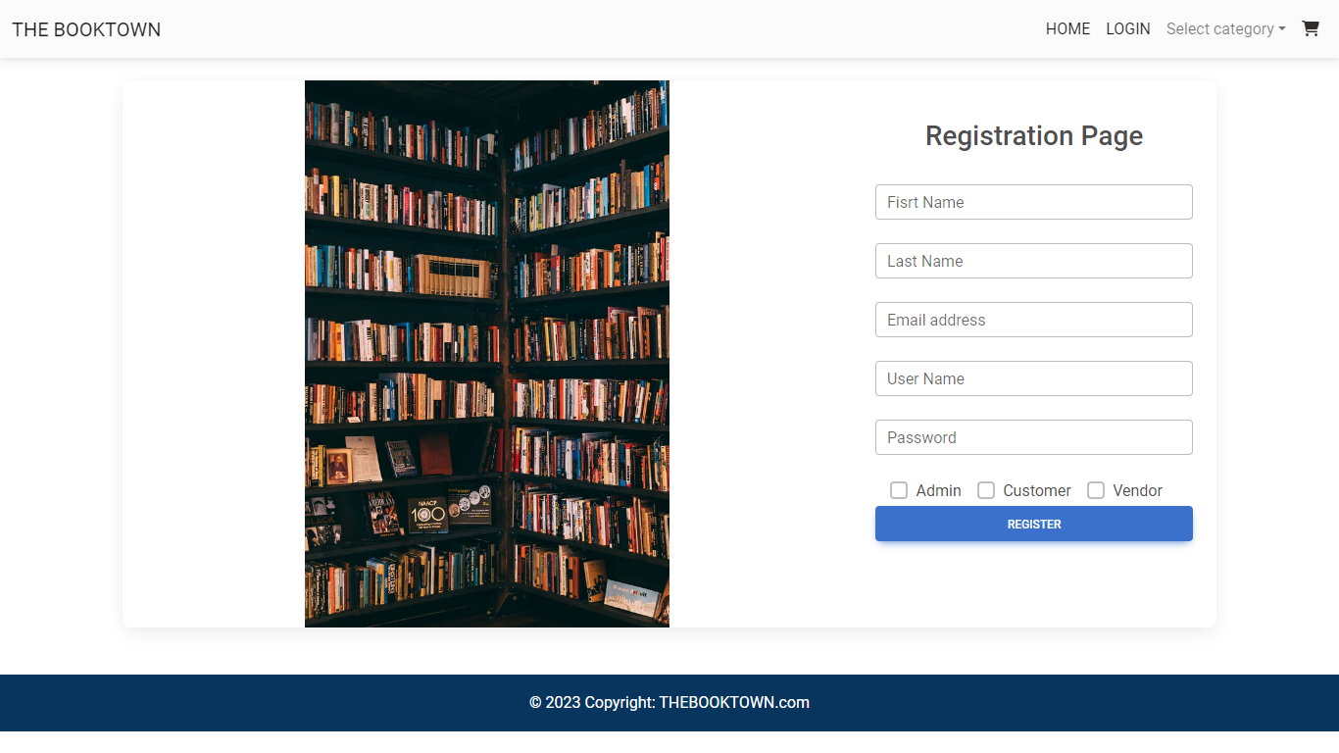

Slide 21
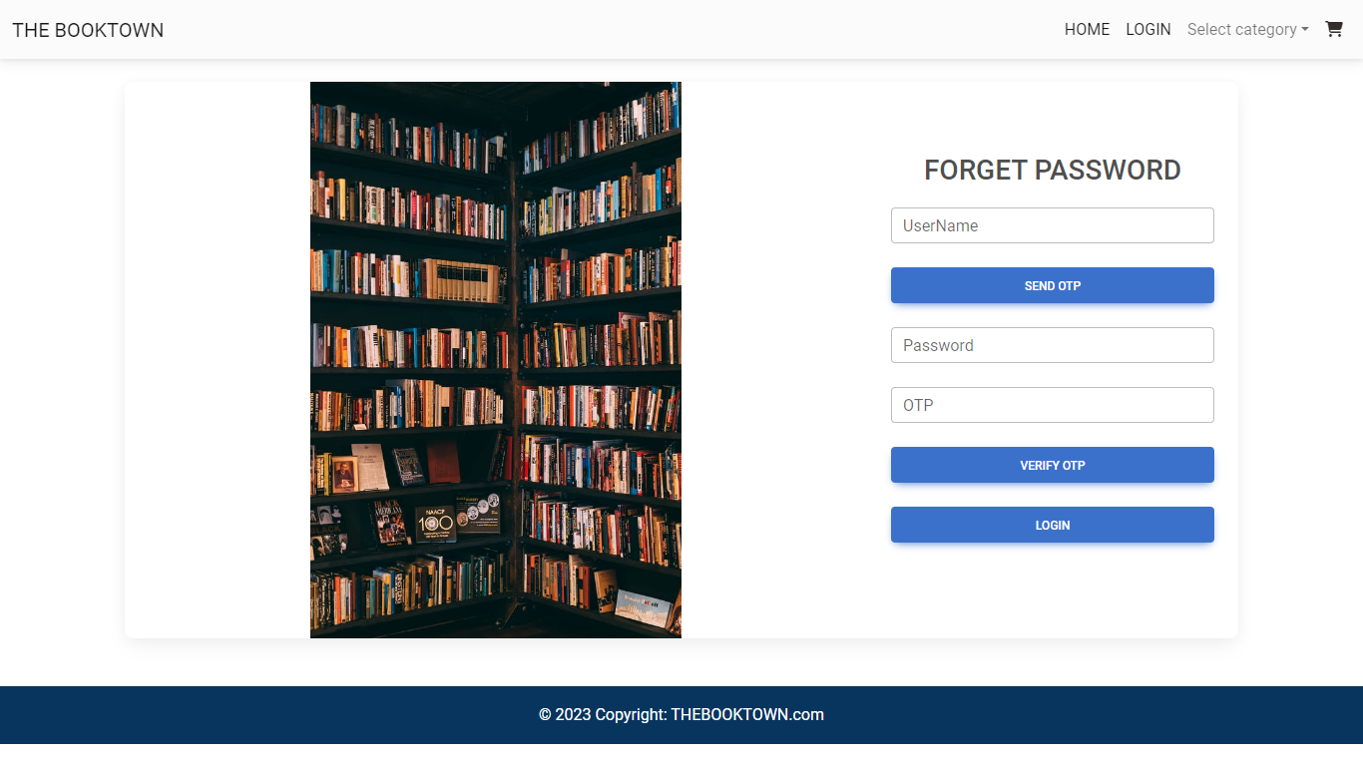
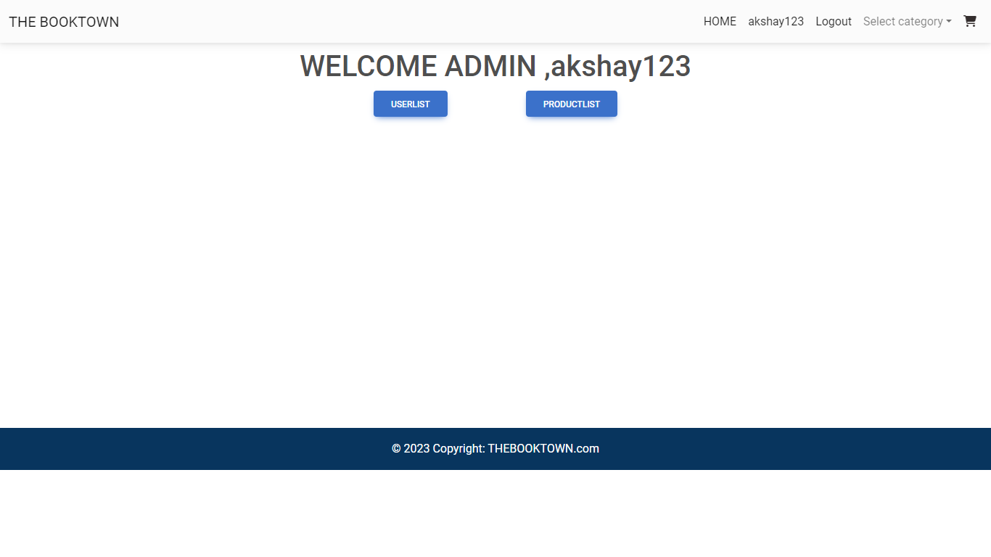

Slide 22
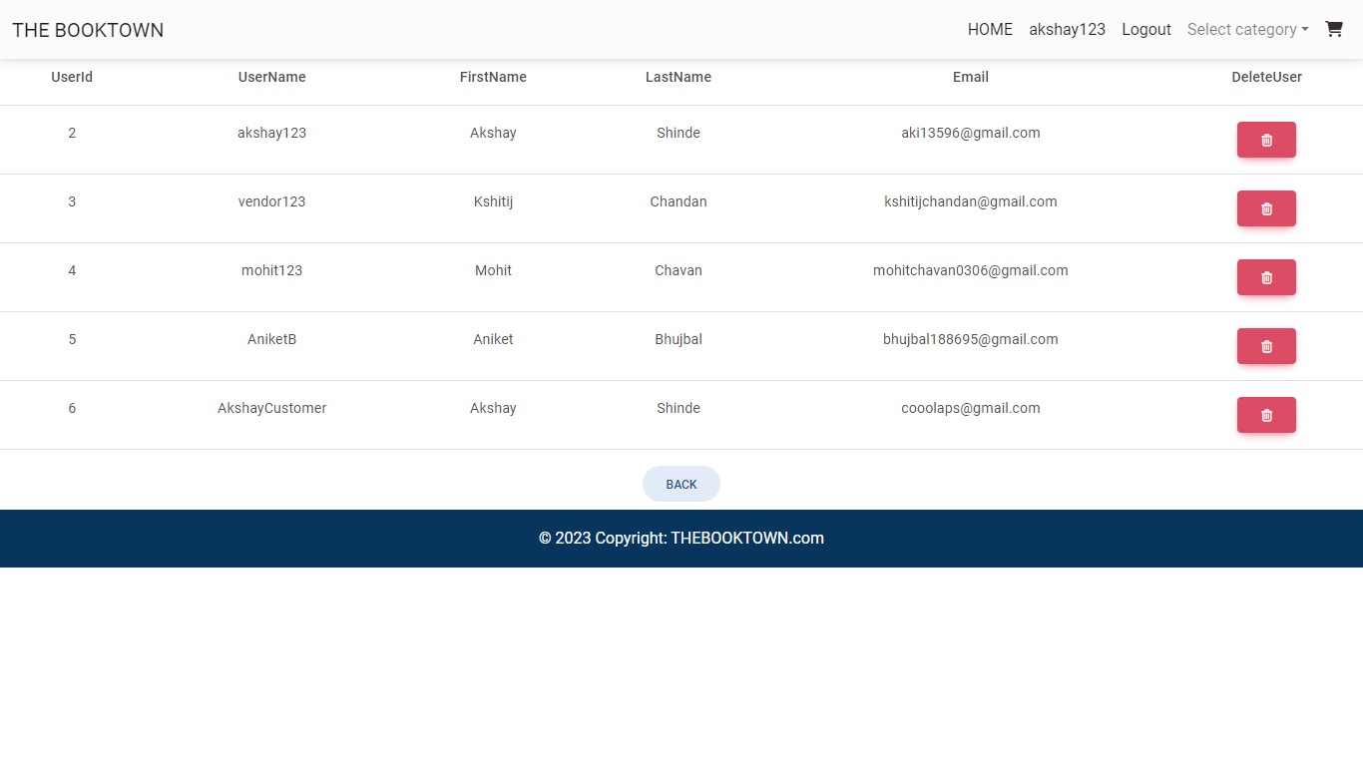
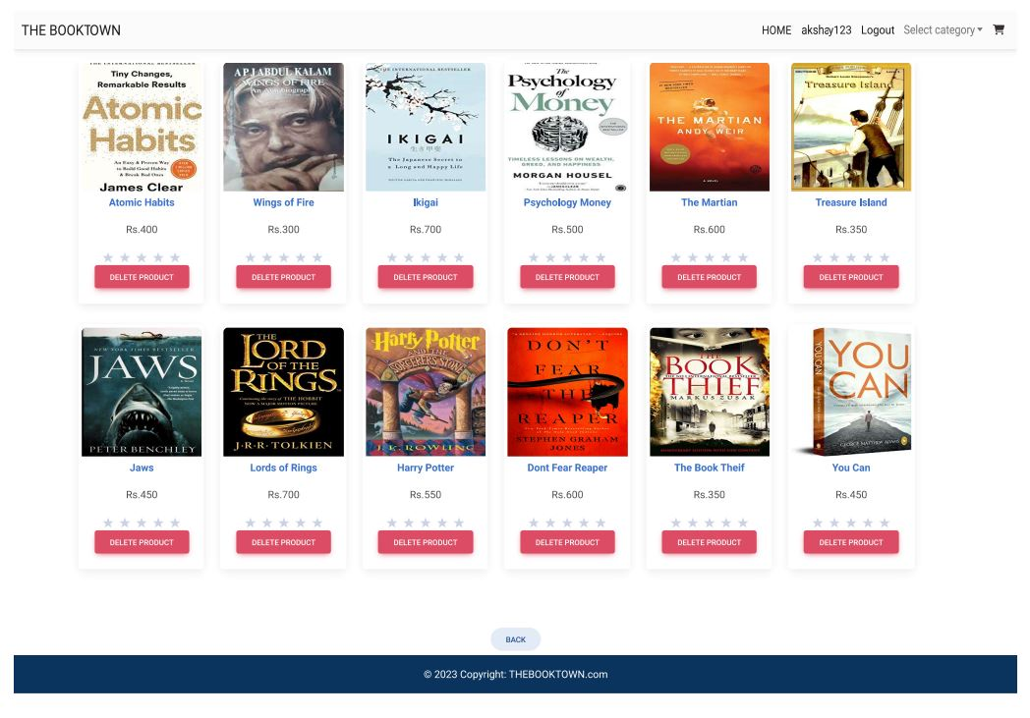

Slide 24
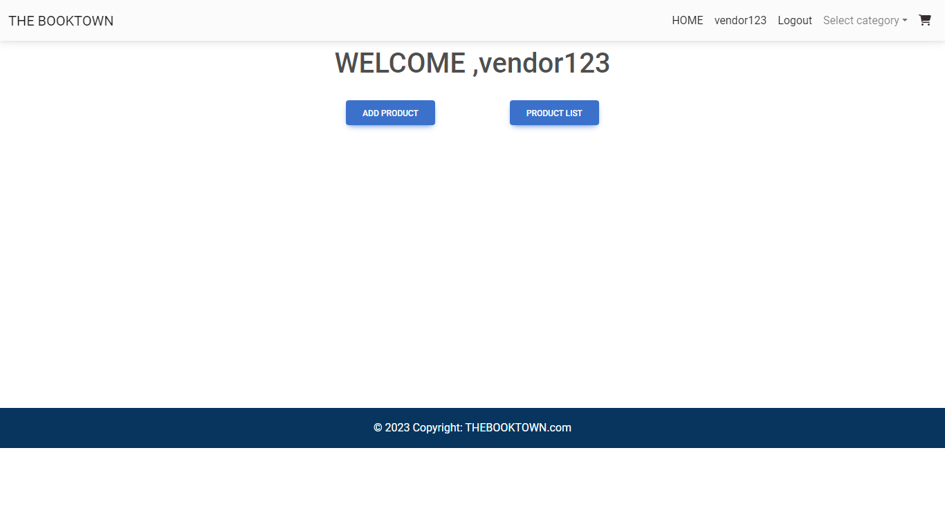

Slide 25
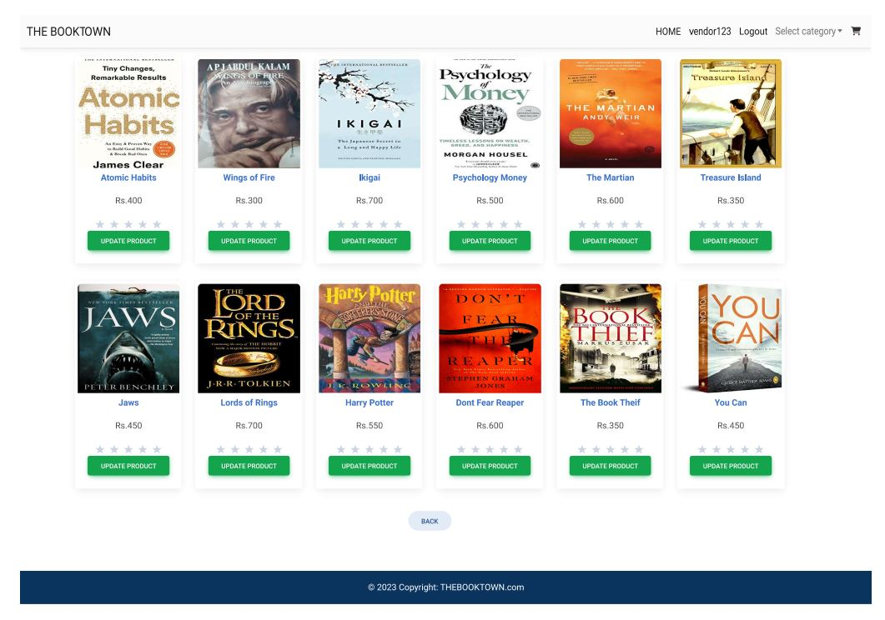
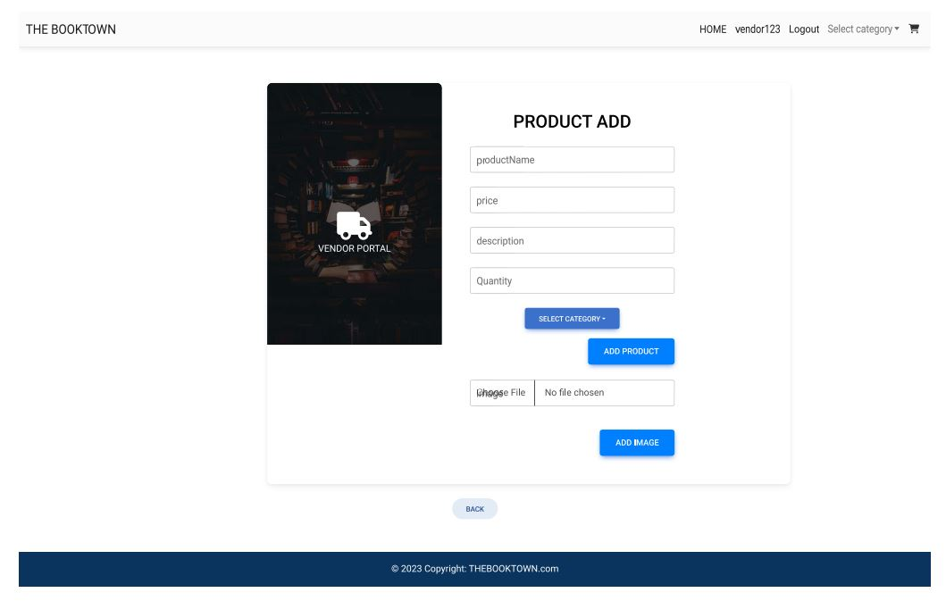

Slide 26
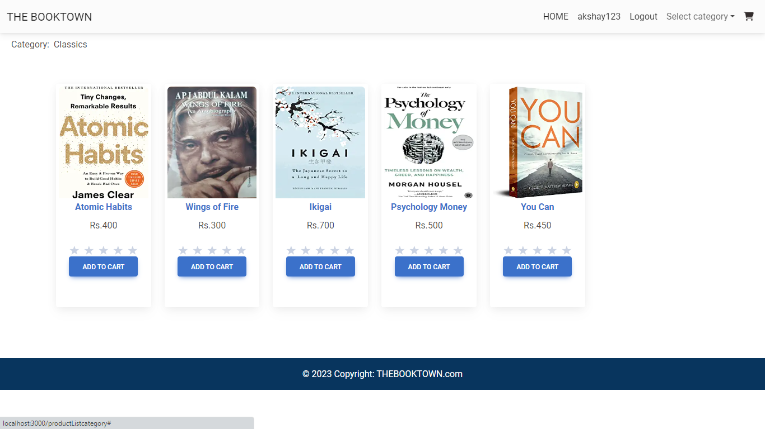
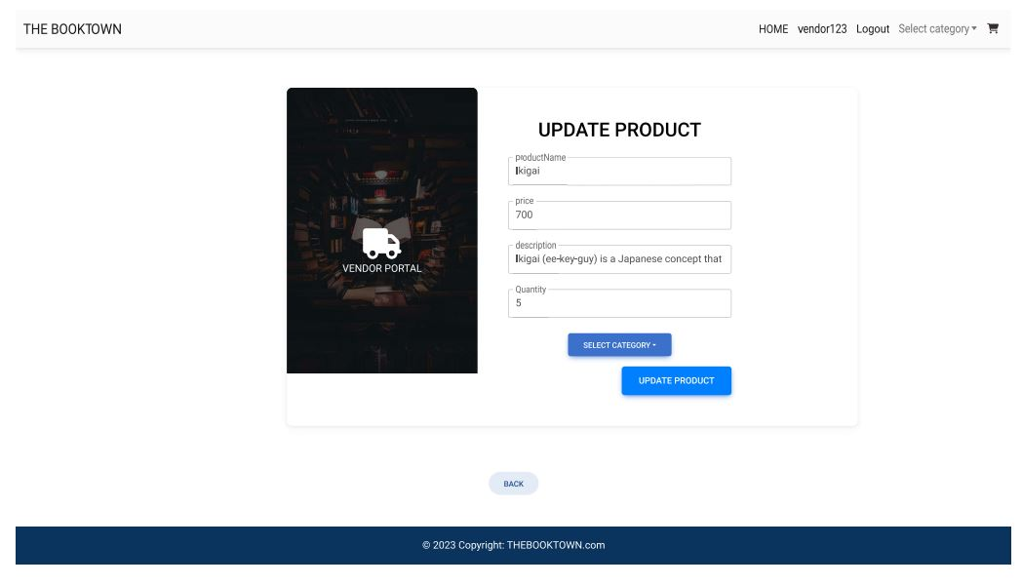

Slide 27
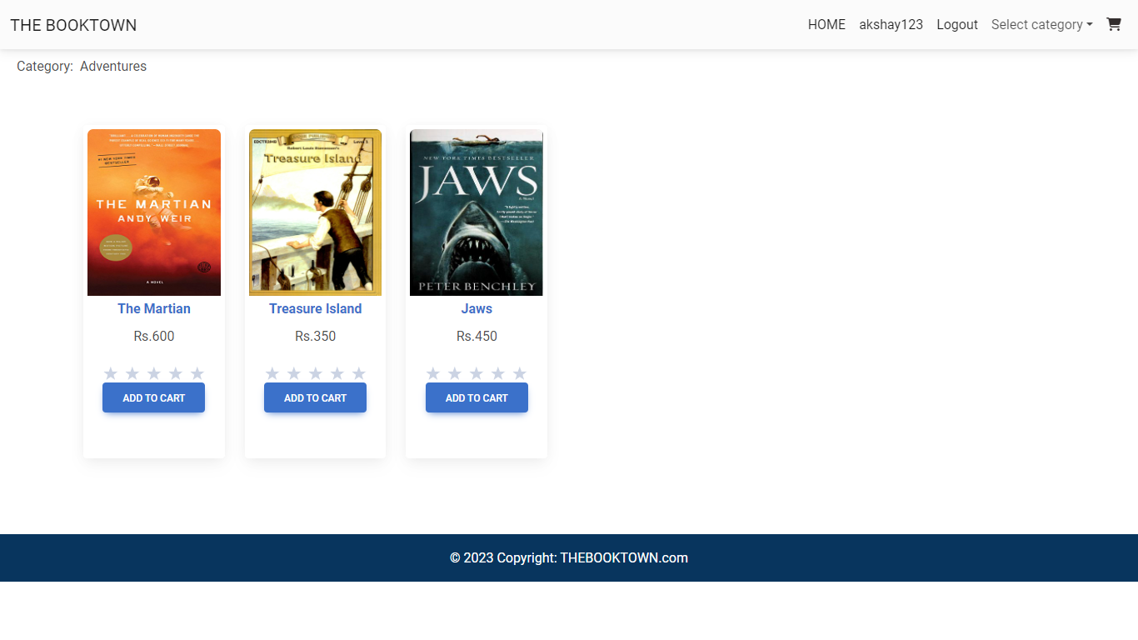

Slide 29
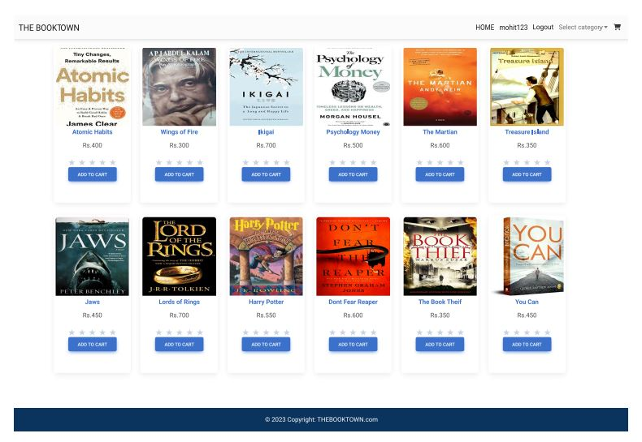

Slide 30
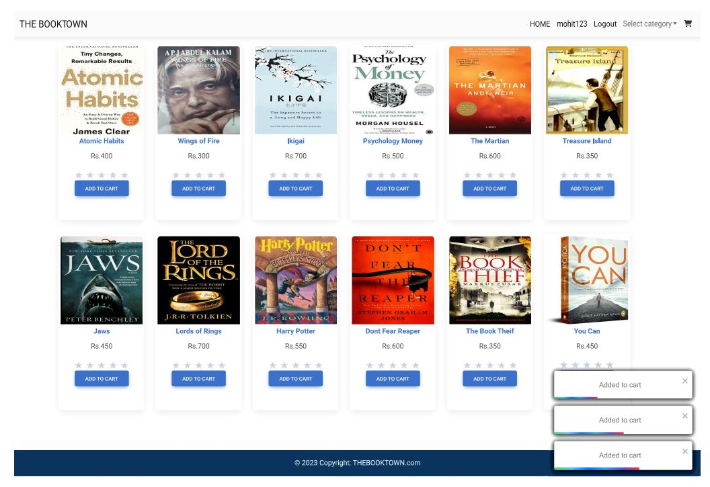
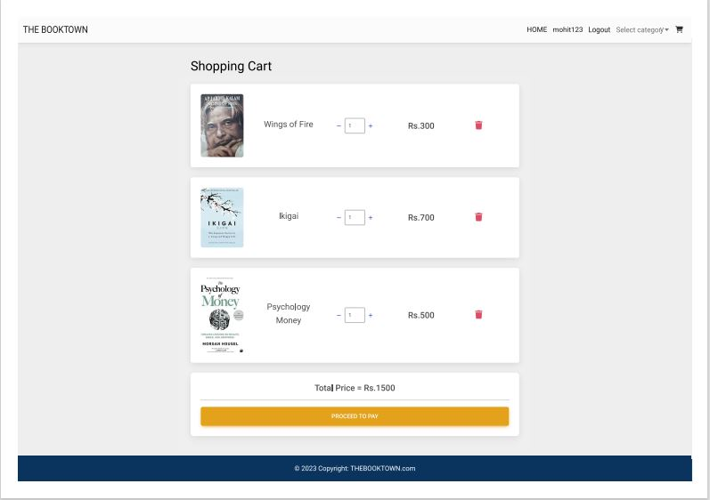

Slide 31
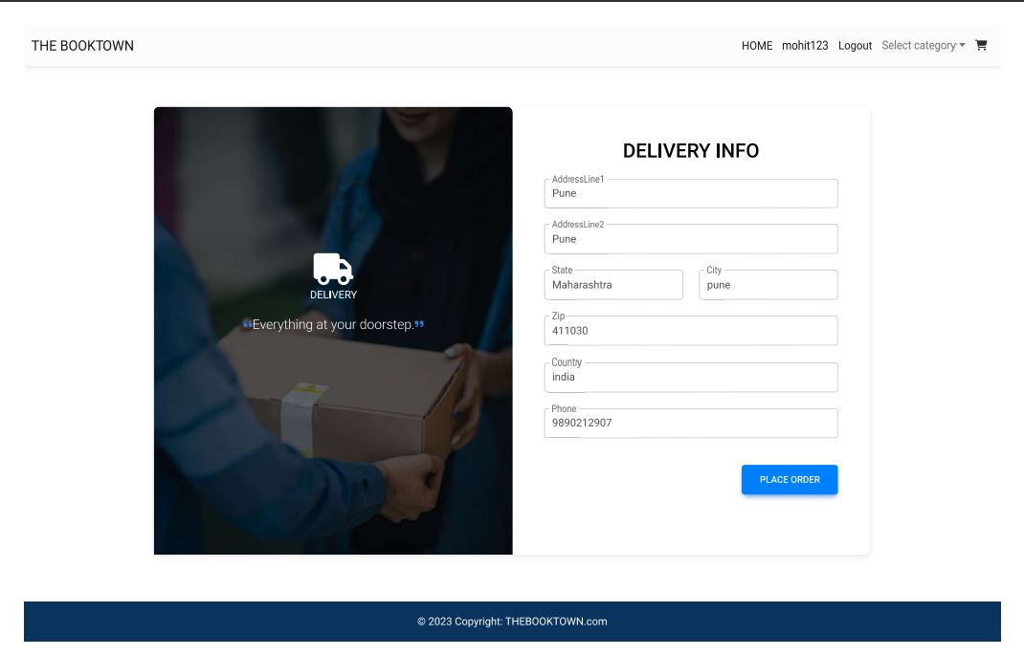
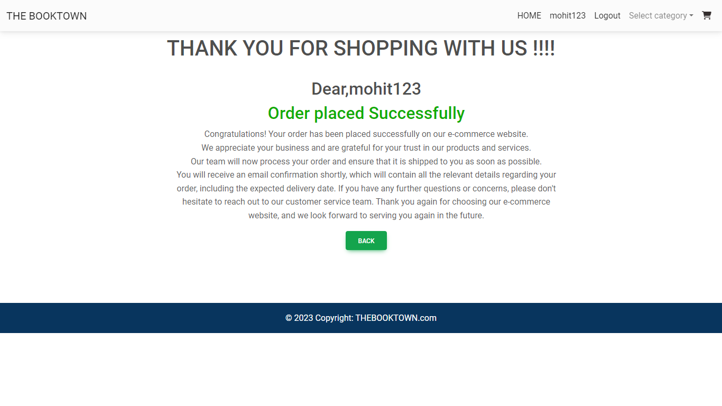

Slide 32
Specifications
The application will use JavaScript and CSS as main web technologies.
HTTP and FTP protocols are used as communication protocols. FTP is used to upload the web application in live domain and the client can access it via HTTP protocol.
SMTP protocol is used for Email communication.
Several types of validations make this web application a secured one and SQL Injections can also be prevented.
Since Student’s Online Portal is a web-based application, internet connection must be established.
The Student’s Online Portal will be used on PCs and will function via internet or intranet in any web browser

Slide 33
Software And HardwareRequirement
Server Side:
Processor: Intel® Xeon® processor 3500 series
HDD: Minimum 500GB Disk Space
RAM: Minimum 8GB
OS: Windows 10, Linux 6
Database: MySQL
Client Side (minimum requirement):
Processor: Intel Dual Core
HDD: Minimum 80GB Disk Space
RAM: Minimum 4GB
OS: Windows 7, Linux

Slide 34
Advantages
Vendor and Customer can access the website from anywhere
Even the Publication House can list their product on the websites
Adding new Product to the web-site is very easy
Get the book at your doorsteps
User Interface is user-friendly
Price of the product is justified

Slide 35
Disadvantages
Sometime the site get crash so that time no one can access that site .
Customer cannot try the product before they buy.
Sometime the in the delivery the product get damage .
E-commerce is highly compitetive.
Shipping time can be lenghty

Slide 36
Conclusion
In the competitive world if you want to grow rapidly you must use the web application to grow the business.
User-friendly interface : The web application should have an easy-to-use and intuitive interface that allows customers to quickly and easily find the books they are looking for.
Customer can order the book from any part of the country at their door steps
Vendor don’t have limited customer because of the website he/she can sell the book all over the country

Slide 37
Future Enhancement

Slide 38
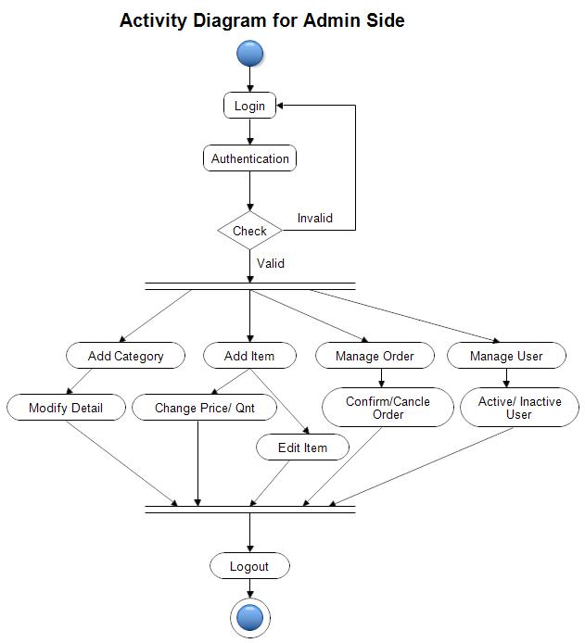

Slide 39
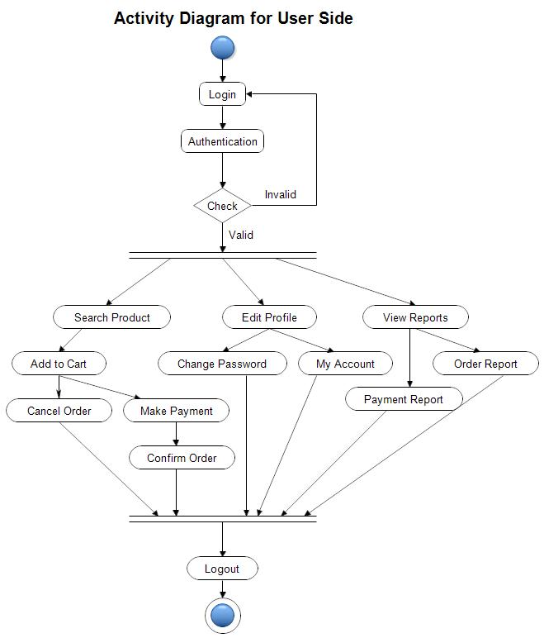

Slide 40
References
https://bootstrapmade.com/mentor-free-education-bootstrap-theme/
https://www.javatpoint.com/java-mail-api-tutorial
https://www.w3schools.com/
https://reactjs.org/docs/getting-started.html
https://javaee.github.io/javaee-spec/javadocs/

Slide 41
Thank you
Any Question

